Slide 1

US Accident ANALYSIS funded by Department for road safety of USa
Urvish Patel
(Chief-Executive of the project)

Slide 2
To assess the current situation on Accidents happening all over the states.
To focus on critical issues, goals and objectives.
To inforce action plans to reduce accidents on roads.
To identify and add on barriers for the safety of road travellers.
1
Agenda
2
3
4
Data SOURCE:
Traffic streaming APIs that broadcast live events
Data COLLECTION METHODOLOGY:
A real-time framework that collects important events (e.g. accidents)

Slide 3
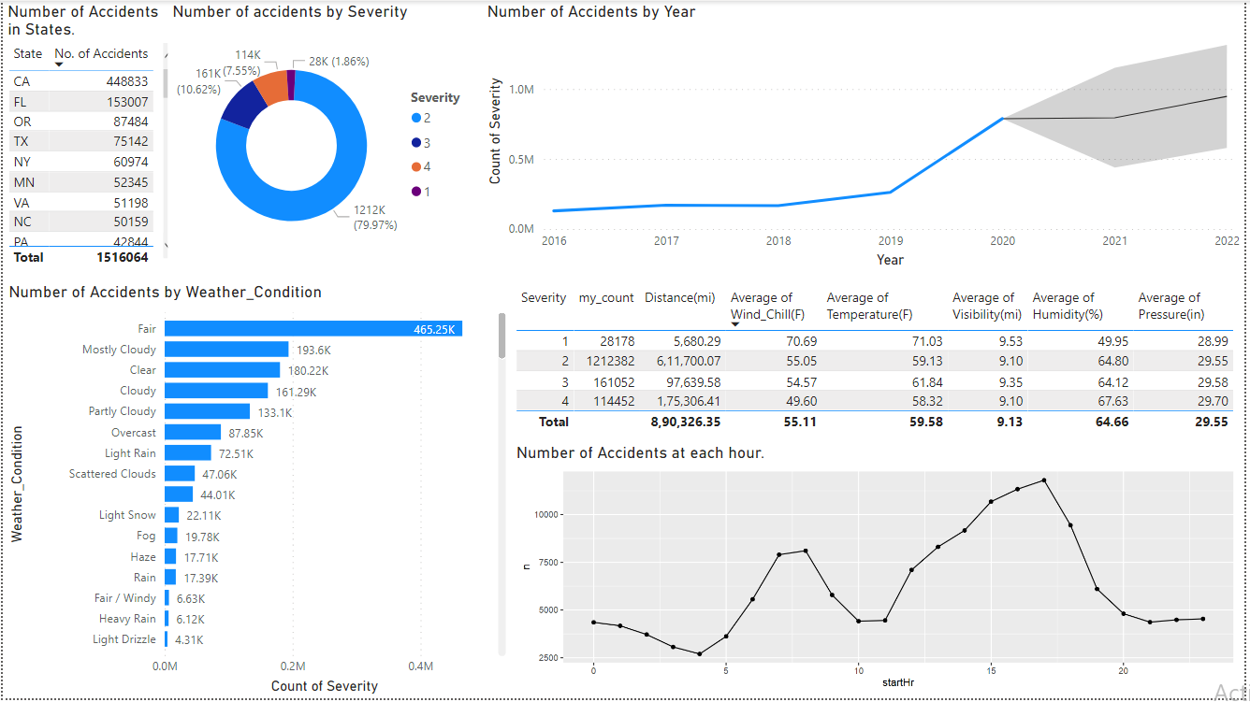
Analysis outcome Through PowerBI
Questions this dashboard answer’s.
What is the count of accidents in each state?
In which Weather Condition do accidents occur most?
Usually at what hour most accidents occur in US?
What type of severity accidents mostly occur?
What are the predictions for the future? What number of accidents we can expect?
What are the number of accidents happened according to severity while considering the average of temperate, humidity, pressure, Visibility, and wind chill?

Slide 4
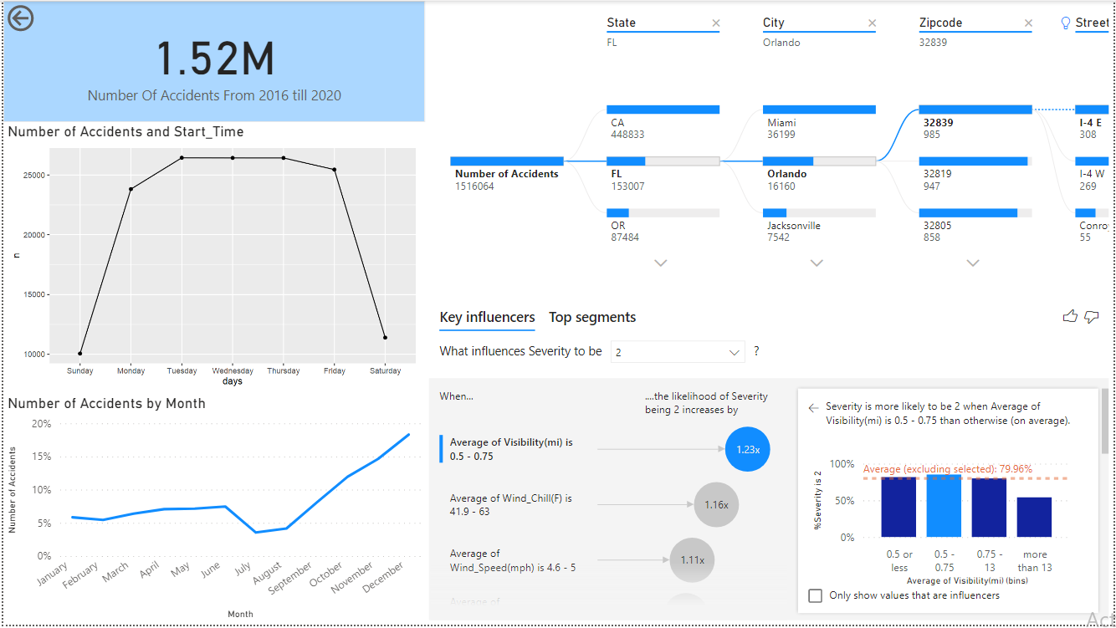
Analysis outcome Through PowerBI
Questions this dashboard answer’s.
What is the number of accidents according to the state, city, zip code and street?
During which Week day accidents occur most?
On what weather factor does the severity of accident depends on?
In what month most accidents occur?
What is the Total number of accidents for the dataset?

Slide 5
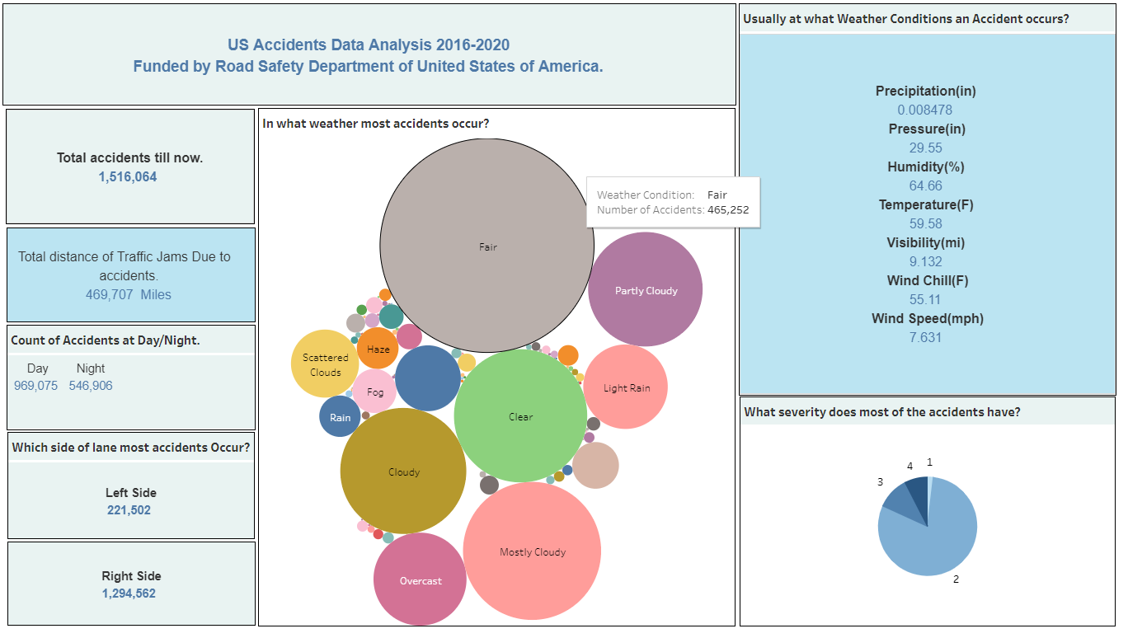
Analysis outcome Through Tableau
Questions this dashboard answer’s.
What is the total number of accidents till now?
What is the total distance in miles affected by the accidents happening on road?
What is the number of accidents happening in daylight and nightlight?
What is the number of accidents happening on left & right side of a lane?
In what weather most accidents occur?
Usually at what Weather Conditions an Accident occurs?

Slide 6
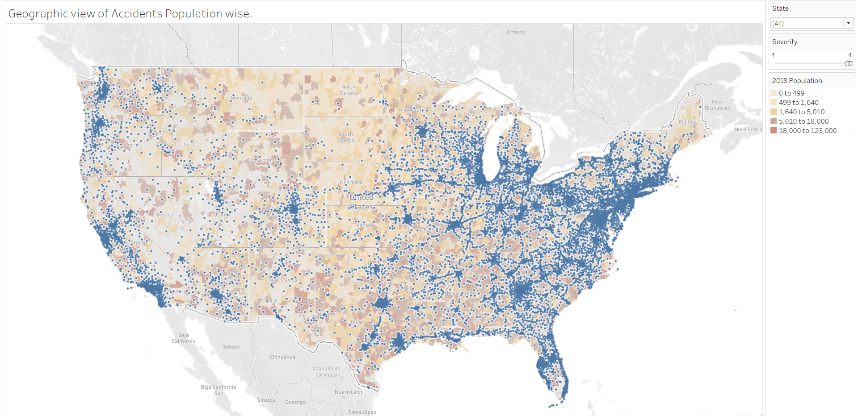
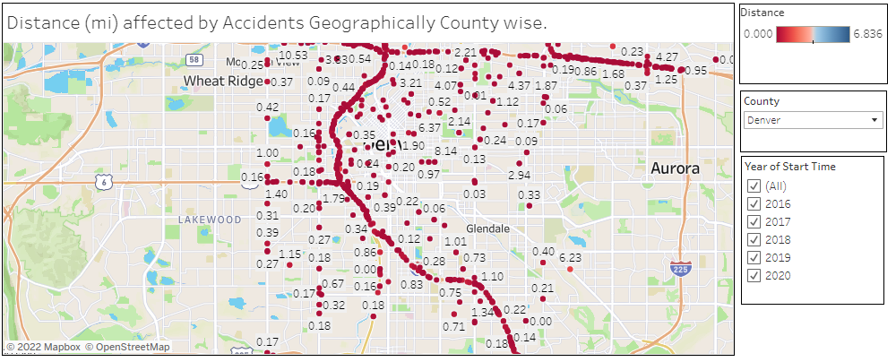
Analysis outcome
Questions this dashboard answer’s.
What is the overview? In which region most number of accidents occur in USA?
Does the number of accidents depend on population of a county?
What is the Distance (mi) affected by Accidents Geographically?

Slide 7
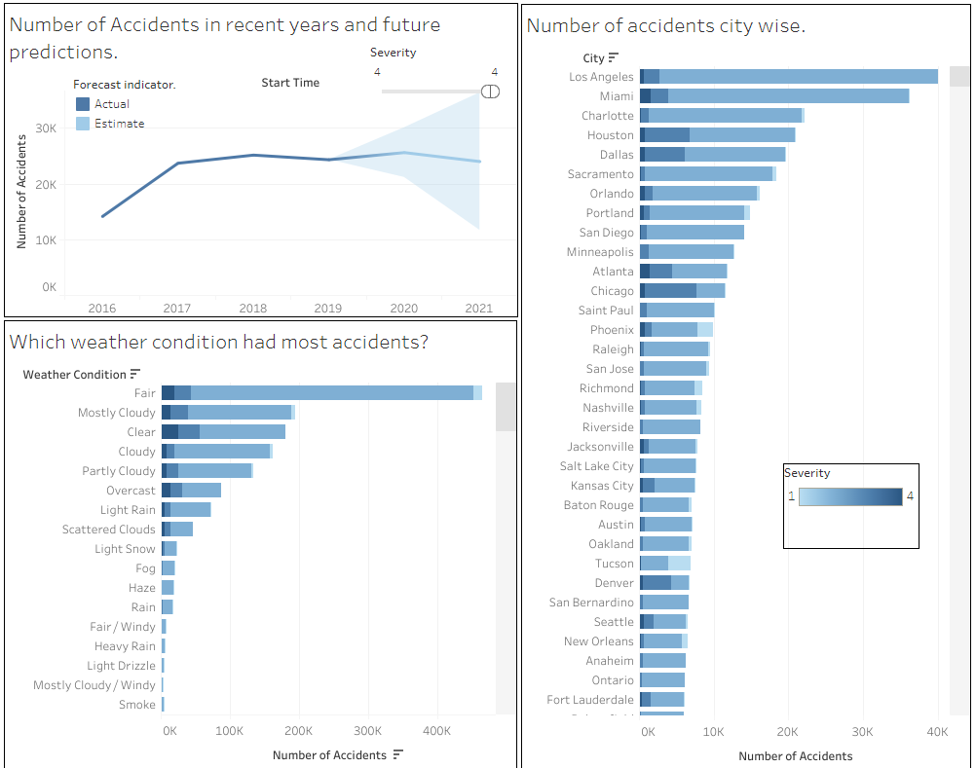
Analysis outcome
Questions this dashboard answer’s.
What are the predictions for the future?
What number of accidents we can expect?
What is the count of accidents in each city? Where is the highest fatality reported?
In which Weather Condition do accidents occur most?

Slide 8
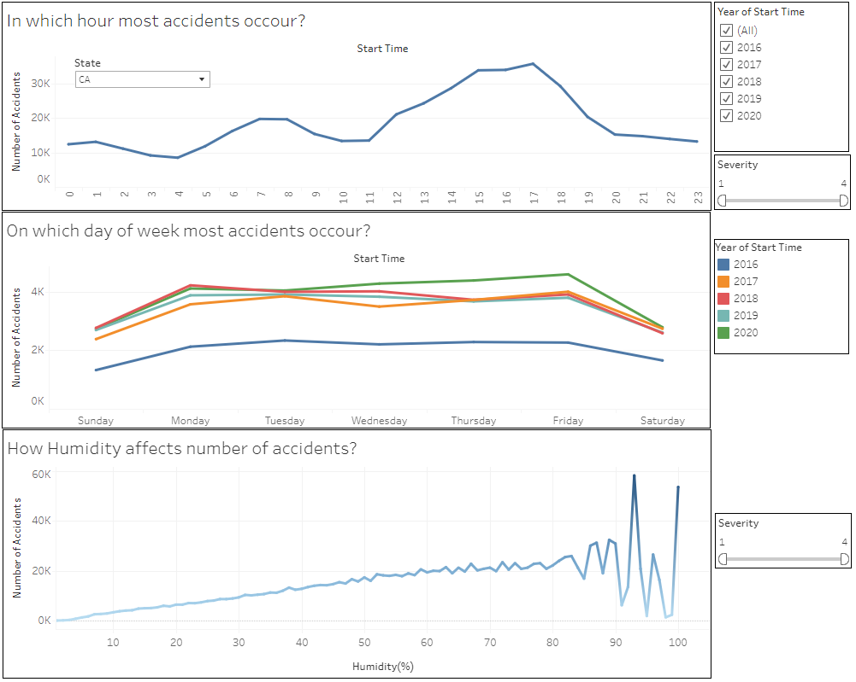
Analysis outcome
Questions this dashboard answer’s.
Usually at what hour most accidents occur in US?
On which day of week most accidents occur?
How the weather conditions like humidity affects the number of accidents?

Slide 9
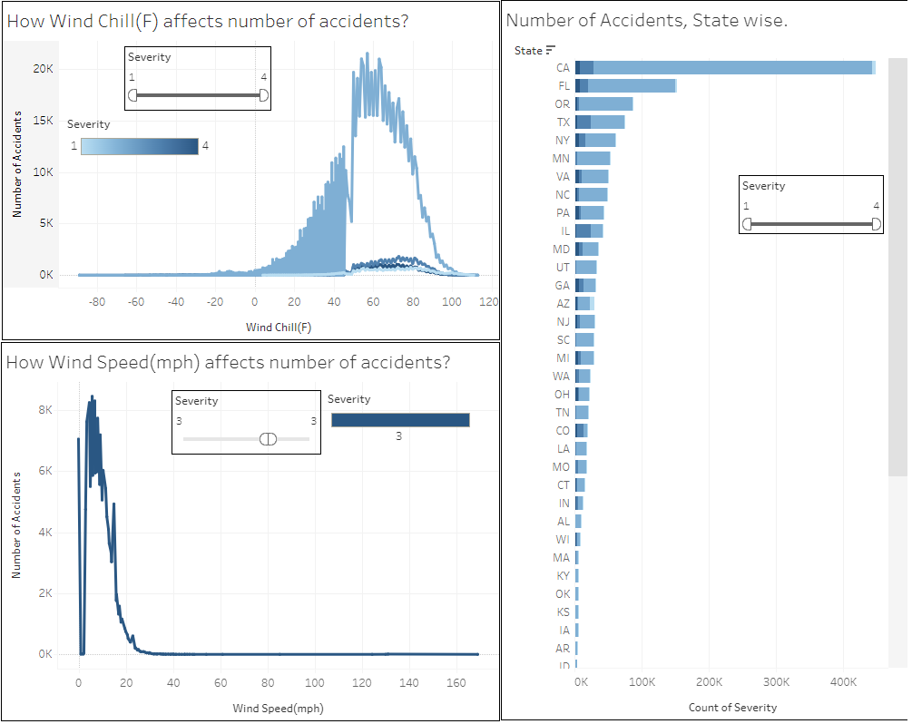
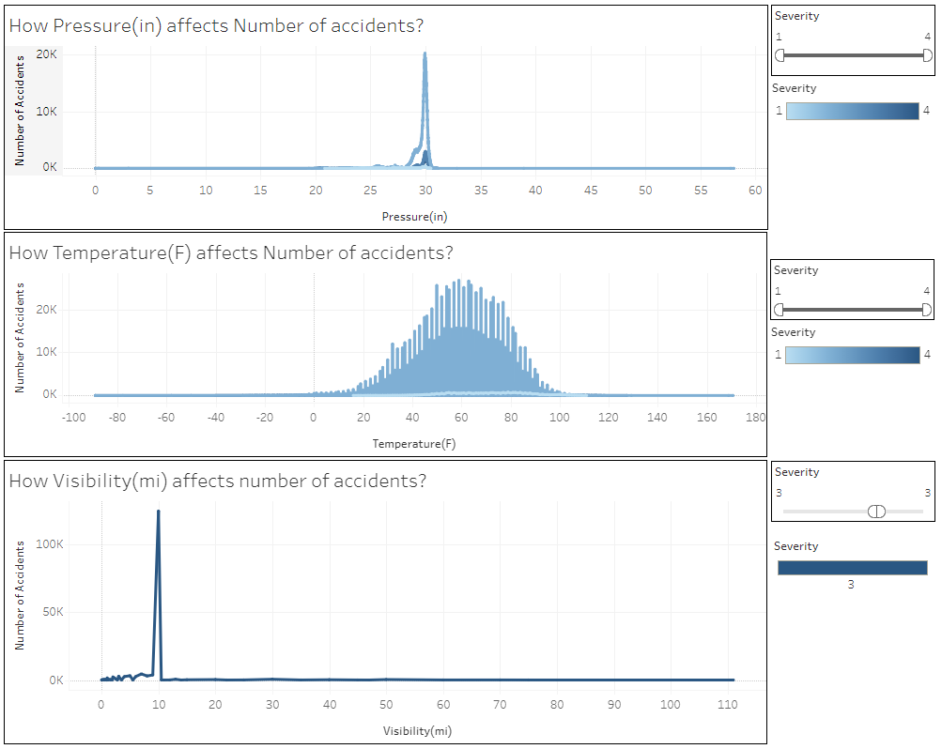
Analysis outcome
Questions these dashboards answer’s.
How the weather conditions like pressure, temperature, visibility, wind chill, & wind speed affects the number of accidents?
2. What is the count of accidents in each state?

Slide 10
Critical Issues while driving on road
Weather updates
Travelers not getting accurate weather updates beforehand.
Right Lane
Accidents happening due shifting lanes on right side.
Freeways
Accidents due to high speed especially on freeways.
Hospitals
Not enough hospitals near highways.
Distractions
More advertisements on freeways.

Slide 11
Recommendations for the issues.
Possible Solutions
The response teams and hospitals must be given special provisions in the hours in which most accidents are occurred.
Warning signs about speed limits are to be put in the accident prone streets.
The state with highest accidents must be provided with better resources and budget plans to avoid accidents and rescue the victims.
Warnings are to be put depending on the weather conditions which cause accidents.
A mandate of vehicles to have first aid kit should be passed.
Online surveillance for prompt response from emergency services should be implemented.
To have enough response teams to rescue in accident prone locations

Slide 12
Factors Affecting Road Traffic Accidents
D
V
Vehicle factors
Driver Behavior
Vehicle type, and the engineering and the safety design standards for vehicle performance. For example, the design of windshield glass and the location and durability of gas tanks can increase safety. Passenger protection systems in vehicles (i.e. air bags, safety belts), if used, can eliminate injuries or reduce their severity.
Alcohol and drug use, reckless operation of vehicle, failure to properly use occupant protection devices, the use of cell phones or texting, and fatigue.
R
T
Traffic volumes
Roadway characteristics
Average annual daily traffic (AADT) or the vehicle miles travelled (VMT). AADT is the average number of vehicles passing a point along a particular road section each day. Thus, AADT represents the vehicle flow over a road section on an average day of the year. VMT refers to the distance travelled by vehicles on roads. It is often used as an indicator of traffic demand and is commonly applied to evaluate mobility patterns and travel trends.
Road geometries and road side conditions, such as well-designed curves and grades, wide lanes, adequate sight distance, clearly visible striping, flared guardrails, good quality shoulders, roadsides free of obstacles, well-located crash attenuation devices, and well-planned use of traffic signals.
T
Time factors
The season of the year, the month of the year, weekdays, and the hour of crash occurrence.

Slide 13
Target
Reduce Number of Accidents
Reducing at least 40% of predicted accidents by 2022.
Increase Public Transportation
Increasing budget for Public Transportation Vehicles. There should be at leat 30% increase in Public transportation vehicles.
Reduce advertisements
Increase Number of Hospitals near Freeways
Reducing 75% advertisements from Freeways, this will not distract drivers.
Increase at least 30% of Hospitals near freeways. Each hospital should have Special Accident Team for incoming Accident affected persons.
Freeway Emergengy Vehicles
Increasing Budget for EMT Vehicles near Freeways. This should be at leat 25%.
Automobile Industry
At least 75% of automobile industry should include first aid kit during manufacturing of vehicles.

Slide 14
Thank You!
Any Questions?

